Slide 1
Augmented Bayesian Networks Integrating Semantics With Extraction and Readability
ANSWER
GE Global Research
Andrew Crapo
Nurali Virani
This material is based upon work supported by the Defense Advanced Research Projects Agency ( DARPA) under Agreement No. HR00111990006.

Slide 2
This slide to be hidden
Outline: 25 minutes suggests ~12 slides max?
Introduction and Overview
Overview diagram and discussion
Domain: NASA Hypersonics—examples drawn from here
Use existing language parsers, process parser-generated AST to extract knowledge, translate to SADL*
Use latest NLP and leverage experience with semantically-informed extraction from text, results to SADL*
Use controlled-English (enhanced SADL**) to
Make OWL more human-readable
Display rules and equations in domain terms
Provide interface to K-CHAIN computational graph
Express results of computation
Enable interactive knowledge exploration***
Support human-in-the-loop knowledge curation
Capture knowledge in OWL augmented with equations and neural networks in Tensor Flow (K-CHAIN)
Summary: emphasize human in the loop
*Capturing both domain concepts and equations, rules
**Enhanced query, richer equations, TBD for results
***Both through controlled-English interface and through graphical means, e.g., SparqlGraph

Slide 3
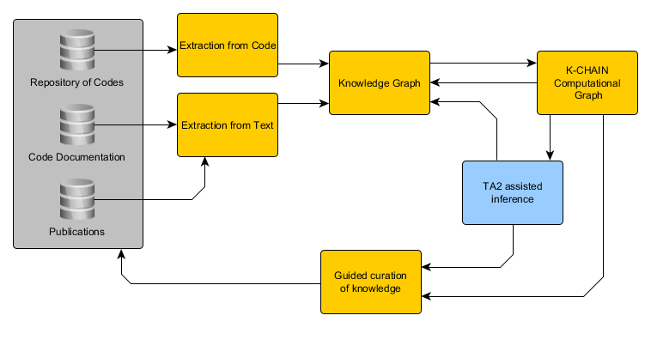
ANSWER Architecture

Slide 4
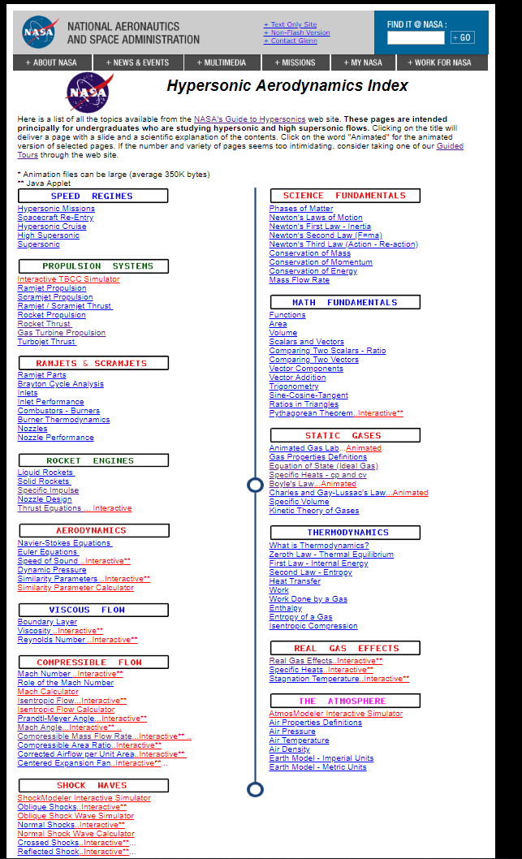
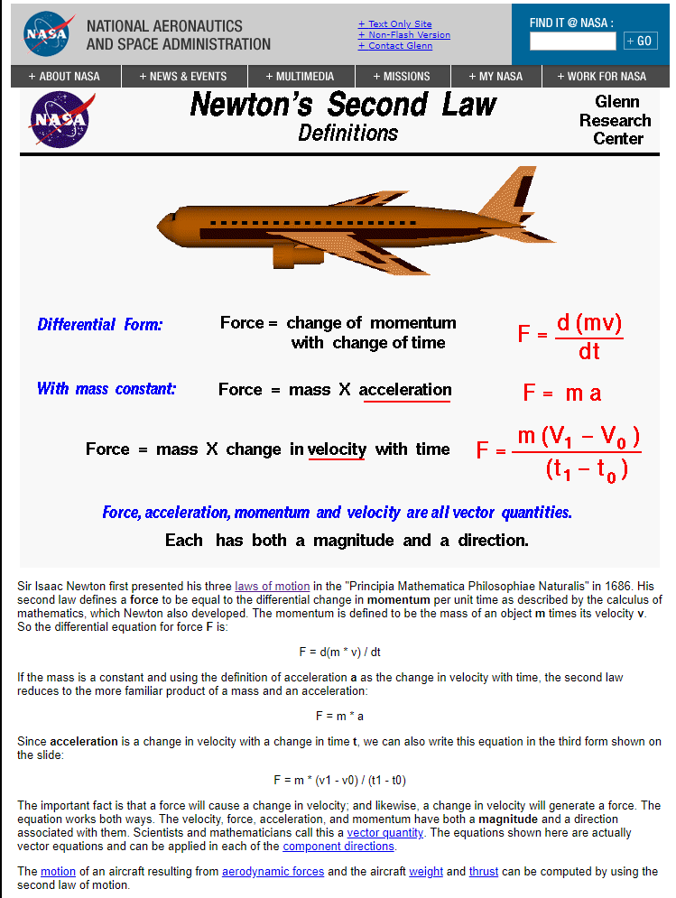
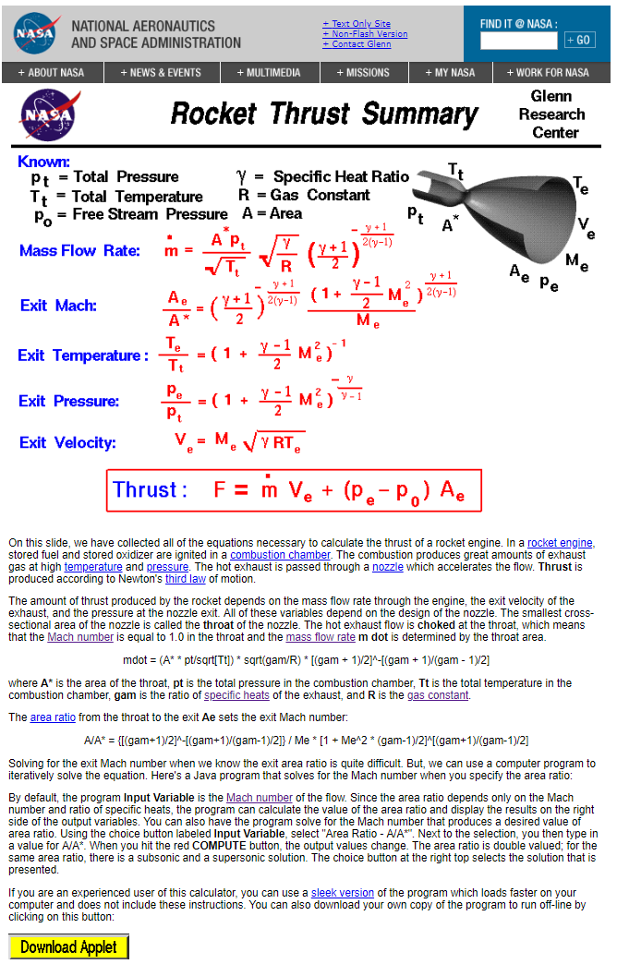
Chosen Domain: NASA GRC’s Hypersonic Aerodynamics Index
From text and equations on science fundamentals, such as Newton’s Second Law, to Java applets for rocket thrust and nozzle design.
“These pages are intended principally for undergraduates who are studying hypersonic and high supersonic flows.”
Image Source: https://www.grc.nasa.gov/WWW/BGH/shorth.html

Slide 5
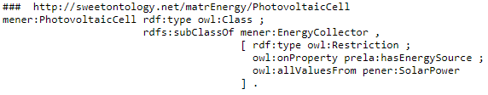
Using Controlled-English for Human-Computer Interfaces
Semantic Application Design Language (SADL*): OWL + Rules , Equations, Queries , Tests , Debug , SCC
 | PhotovoltaicCell is a type of EnergyCollector. hasEnergySource of PhotovoltaicCell only has values of type SolarPower.
… a force [is] the differential change in momentum per unit time ... The momentum is defined to be the mass of an object m times its velocity v. So the differential equation for force F is: F = d(m * v) / dt (https://www.grc.nasa.gov/www/BGH/newton2.html) | Force is a type of UnittedQuantity. ForceFromMomentum is a type of Derivation. derivedFrom of ForceFromMomentum has exactly 1 value of type Momentum. produces of ForceFromMomentum has exactly 1 value of type Force. withRespectTo of ForceFromMomentum always has value ^time. ^order of ForceFromMomentum always has value 1. force describes PhysicalObject with values of type Force. Or Rule newtons2ndLaw: if o is a PhysicalObject and p is momentum of o and [fv, fu] is derivative(p, ^time, 1) then there exists (a Force with ^value fv, with unit fu) and force of o is the Force.
(http://sweetontology.net/matrEnergy )
*See http://sadl.sourceforge.net, http://github.com/crapo/sadlos2

Slide 6
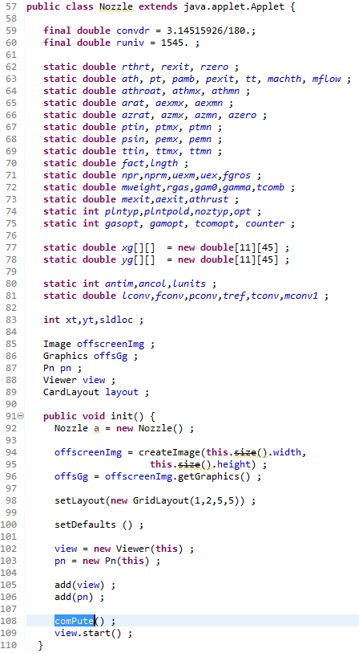
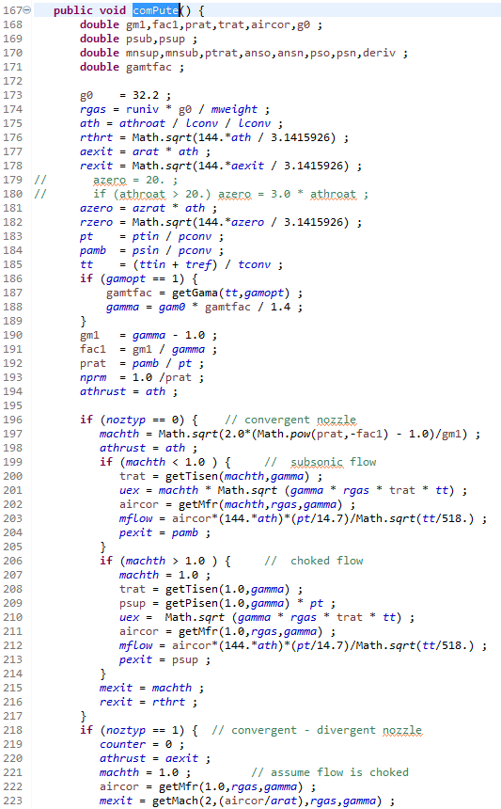
Scientific Model Extraction from Code

Slide 7
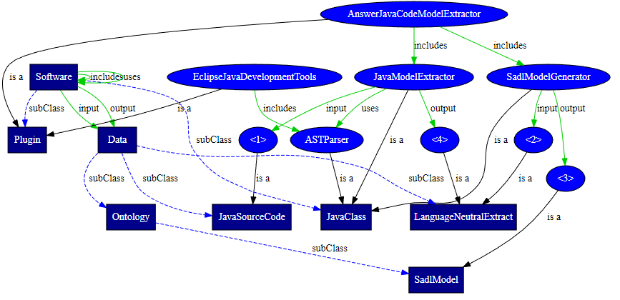
An Ontological View of Extraction from Code
Software is a class.
uses describes Software with values of type Software.
includes describes Software with values of type Software.
input describes Software with values of type Data.
output describes Software with values of type Data.
Data is a class.
Plugin is a type of Software.
JavaClass is a type of Software.
JavaSourceCode is a type of Data.
Ontology is a type of Data.
SadlModel is a type of Ontology.
LanguageNeutralExtract is a type of Data.
EclipseJavaDevelopmentTools is a Plugin,
includes ASTParser.
ASTParser is a JavaClass.
JavaModelExtractor is a JavaClass, uses ASTParser, has input
(a JavaSourceCode), has output (a LanguageNeutralExtract).
SadlModelGenerator is a JavaClass, has input
(a LanguageNeutralExtract), has output (a SadlModel).
AnswerJavaCodeModelExtractor is a Plugin,
includes JavaModelExtractor,
includes SadlModelGenerator.
Extraction from text will be used to process comments in context

Slide 8


Scientific Model Extraction from Text
Equation and Scientific Concepts Labeler
Link to existing concepts in internal and external KGs
Relation Extraction
Knowledge Graph Ingestion
Custom named entity recognition system
Knowledge Graph
ANSWER KG
Examples:
The differential equation for force F is: F = d(m * v) / dt.
extraction of equations and concepts
The differential equation for force F is: F = d(m * v) / dt.
Concept
Equation
Force depends on mass and acceleration
<force> <depends> <mass>
<force> <depends> <acceleration>
Force depends on mass and acceleration
Concept
Concept
Concept
extraction of equations and concepts
extraction of relation between concepts

Slide 9
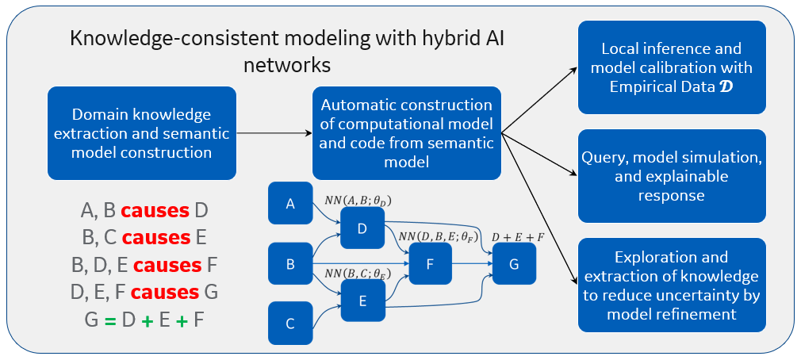
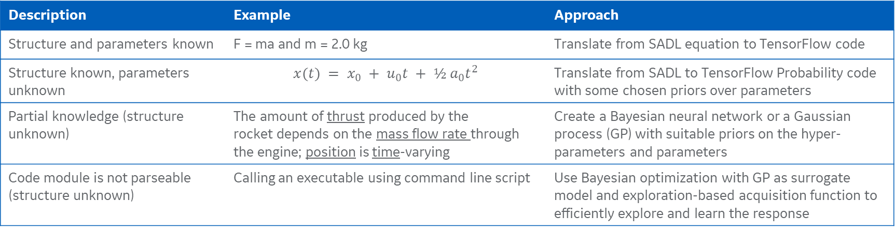
Computational modeling and knowledge representation
Key ideas of K-CHAIN
Converting inexactness and incompleteness of knowledge to model uncertainty in a Bayesian framework
Allow local inference for model calibration and learning when any data is available
Use model uncertainty to guide further knowledge curation
Local graph operations to append, prune, or refine
Capture variety of domain knowledge
Description | Example | Approach
Structure and parameters known | F = ma and m = 2.0 kg | Translate from SADL equation to TensorFlow code
Structure known, parameters unknown | $$x(t) = x_{0} + u_{0}t + ½ a_{0}t^{2}$$ | Translate from SADL to TensorFlow Probability code with some chosen priors over parameters
Partial knowledge (structure unknown) | The amount of thrust produced by the rocket depends on the mass flow rate through the engine; position is time-varying | Create a Bayesian neural network or a Gaussian process (GP) with suitable priors on the hyper-parameters and parameters
Code module is not parseable (structure unknown) | Calling an executable using command line script | Use Bayesian optimization with GP as surrogate model and exploration-based acquisition function to efficiently explore and learn the response
Degree of Inexactness

Slide 10
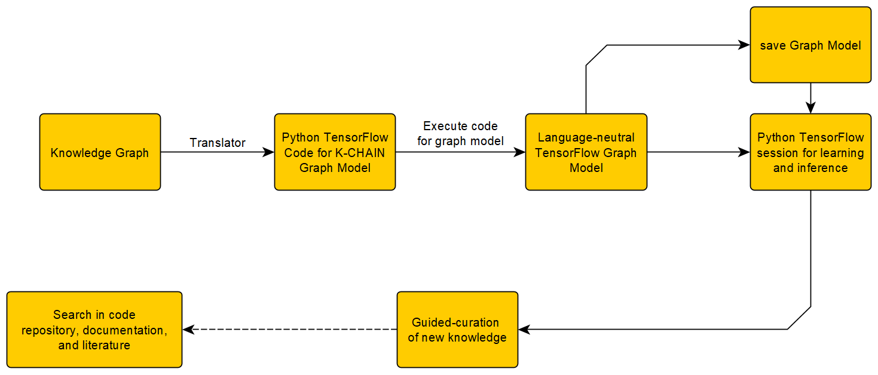

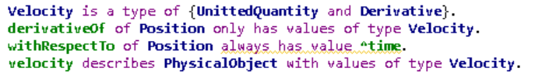
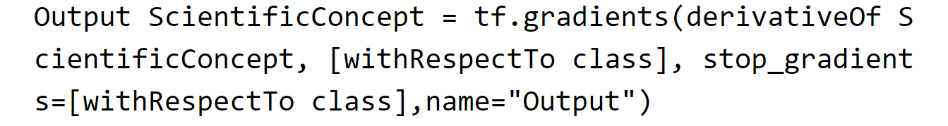

Creation of computational model from knowledge graph
Overview of computational graph creation approach
Translation of Semantic Model in SADL to TensorFlow example
Definition of derivative:
Example of derivative:
Key steps:
In TensorFlow:
Translation:
Graph creation:
Graph orchestration:
Translate (structured) semantic model from SADL to (structured) Python TensorFlow code for the computational graph
Execute the code and use inherent TensorFlow capability to create and then save a language-neutral Graph model
Use the Graph model in TensorFlow session to demonstrate code execution using internal TensorFlow compiler
Example of derivative:

Slide 11
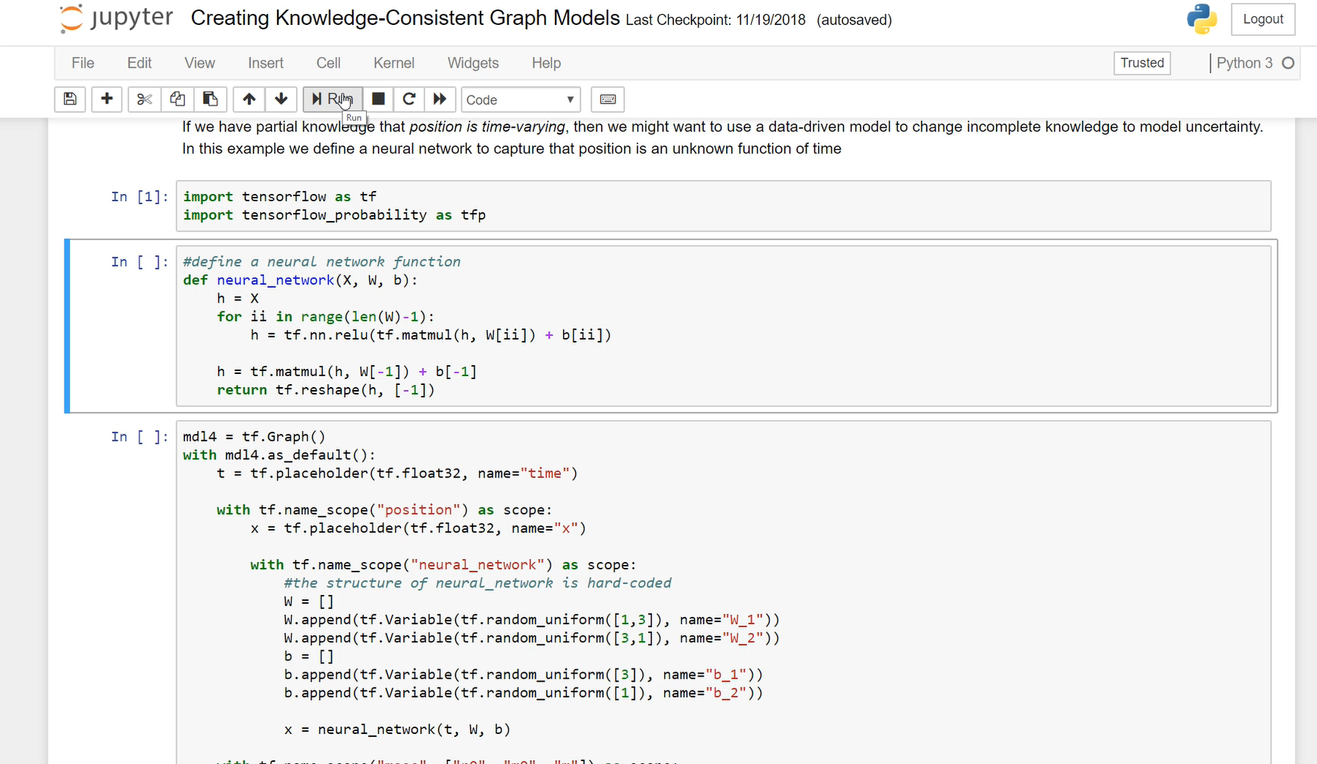
Demo for Computational Graph for Newton’s 2nd Law

Slide 12
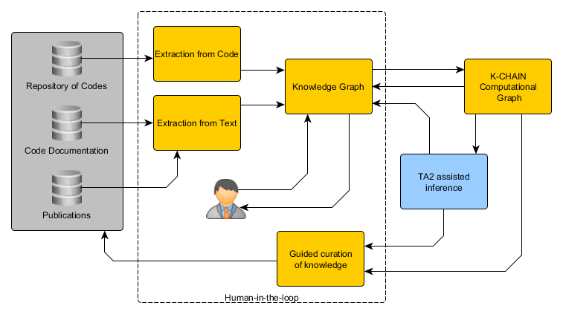
Summary: It’s a Hard Problem —Man-Machine Symbiosis Will be Critical to Success
Over time process can become increasingly robust and require less human interaction.

Slide 13
Questions?

